Slide 1
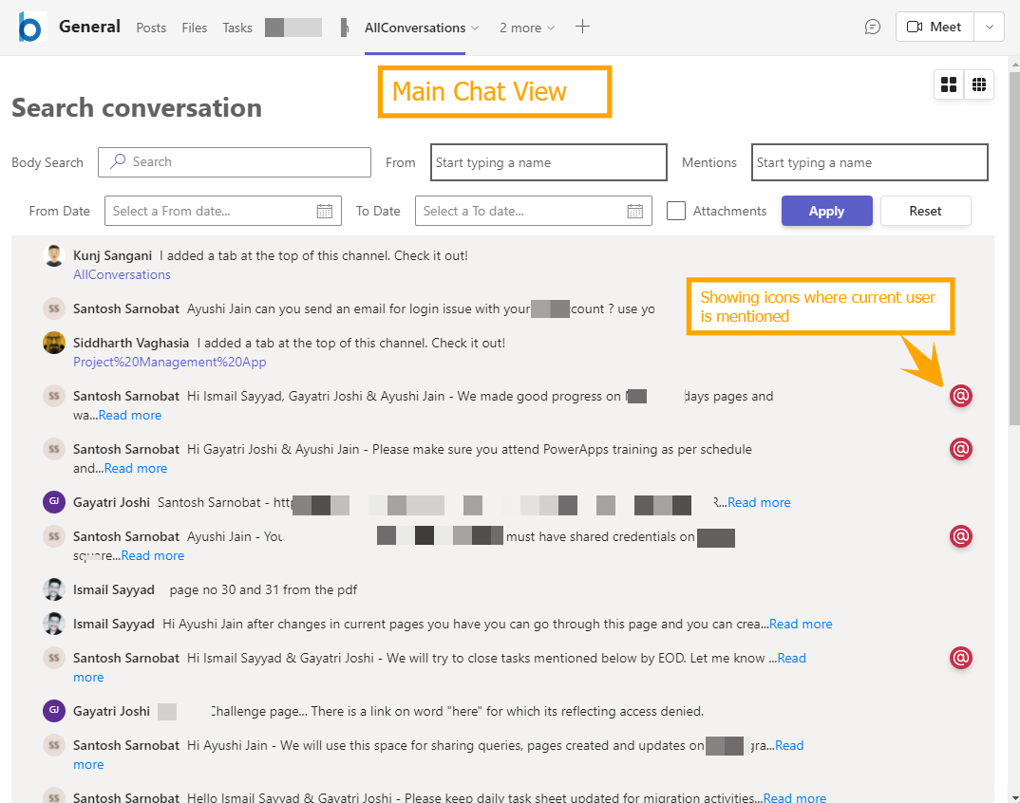

Conversations Search experience for Microsoft Teams with SPFx
react-teams-conversationview
Siddharth Vaghasia (@siddh_me)
Kunj Sangani (@kunj-sangani)

Slide 2












Siddharth Vaghasia
Microsoft 365 | Founder | BinaryRoots
SharePoint, Teams App, Power Platform, Azure, .NET
https://siddharthvaghasia.com
https://c-sharpcorner.com/members/siddharth-vaghasia
@siddh_me
siddharth-vaghasia
https://www.linkedin.com/in/siddharthvaghasia

Slide 3




Kunj Sangani
Technical Consultant - SharePoint, Office 365, Azure, .NET, NODE JS
Speaker | Blogger | PnP contributor | C# Corner MVP
https://www.c-sharpcorner.com/members/kunj-sangani
@sanganikunj
https://www.linkedin.com/in/kunjsangani
kunj-sangani
sangani.kunj@gmail.com
kunj.sangani

Slide 4

react-teams-conversationview
Webpart to show channel’s conversation in simple manner
https://github.com/pnp/sp-dev-fx-webparts/tree/main/samples/react-teams-conversationview

Slide 5
Driving factors
Messages overloaded
Finding the right messages within conversation
Scan and locate relevant information
Meaningful conversations

Slide 6
Summary
Displays all the New(Parent) Conversations on the top
Ability to view all the replies of particular conversation
Option to go to message or reply
Find messages based on different filters
Body search(free text)
Based on sender(from)
Based on mentions(who all were mentioned in that message)
From and To date
With Attachments
Display options - Chat format vs Tabular view
Ability to use same filters on all the replies
Icon on message where current user is mentioned.
Using Graph Toolkit in SPFx

Slide 7
Reference links
https://learn.microsoft.com/en-us/sharepoint/dev/spfx/web-parts/get-started/using-web-part-as-ms-teams-tab
https://learn.microsoft.com/en-us/microsoftteams/platform/sbs-gs-spfx?tabs=vscode%2Cviscode

Slide 8
Demo/ Code Walkthrough

Slide 9
THANK YOU

